Slide 1
Basic Use of Metrology Tools for QC Based on 3D Scanning and Point Clouds

Slide 2
Contents
Key Concepts of Metrology
Quality Control Sensors and Software
Reference Architecture of the QC Solution
Basic Use of the Solution
Next Steps

Slide 3
Key concepts of metrology

Slide 4
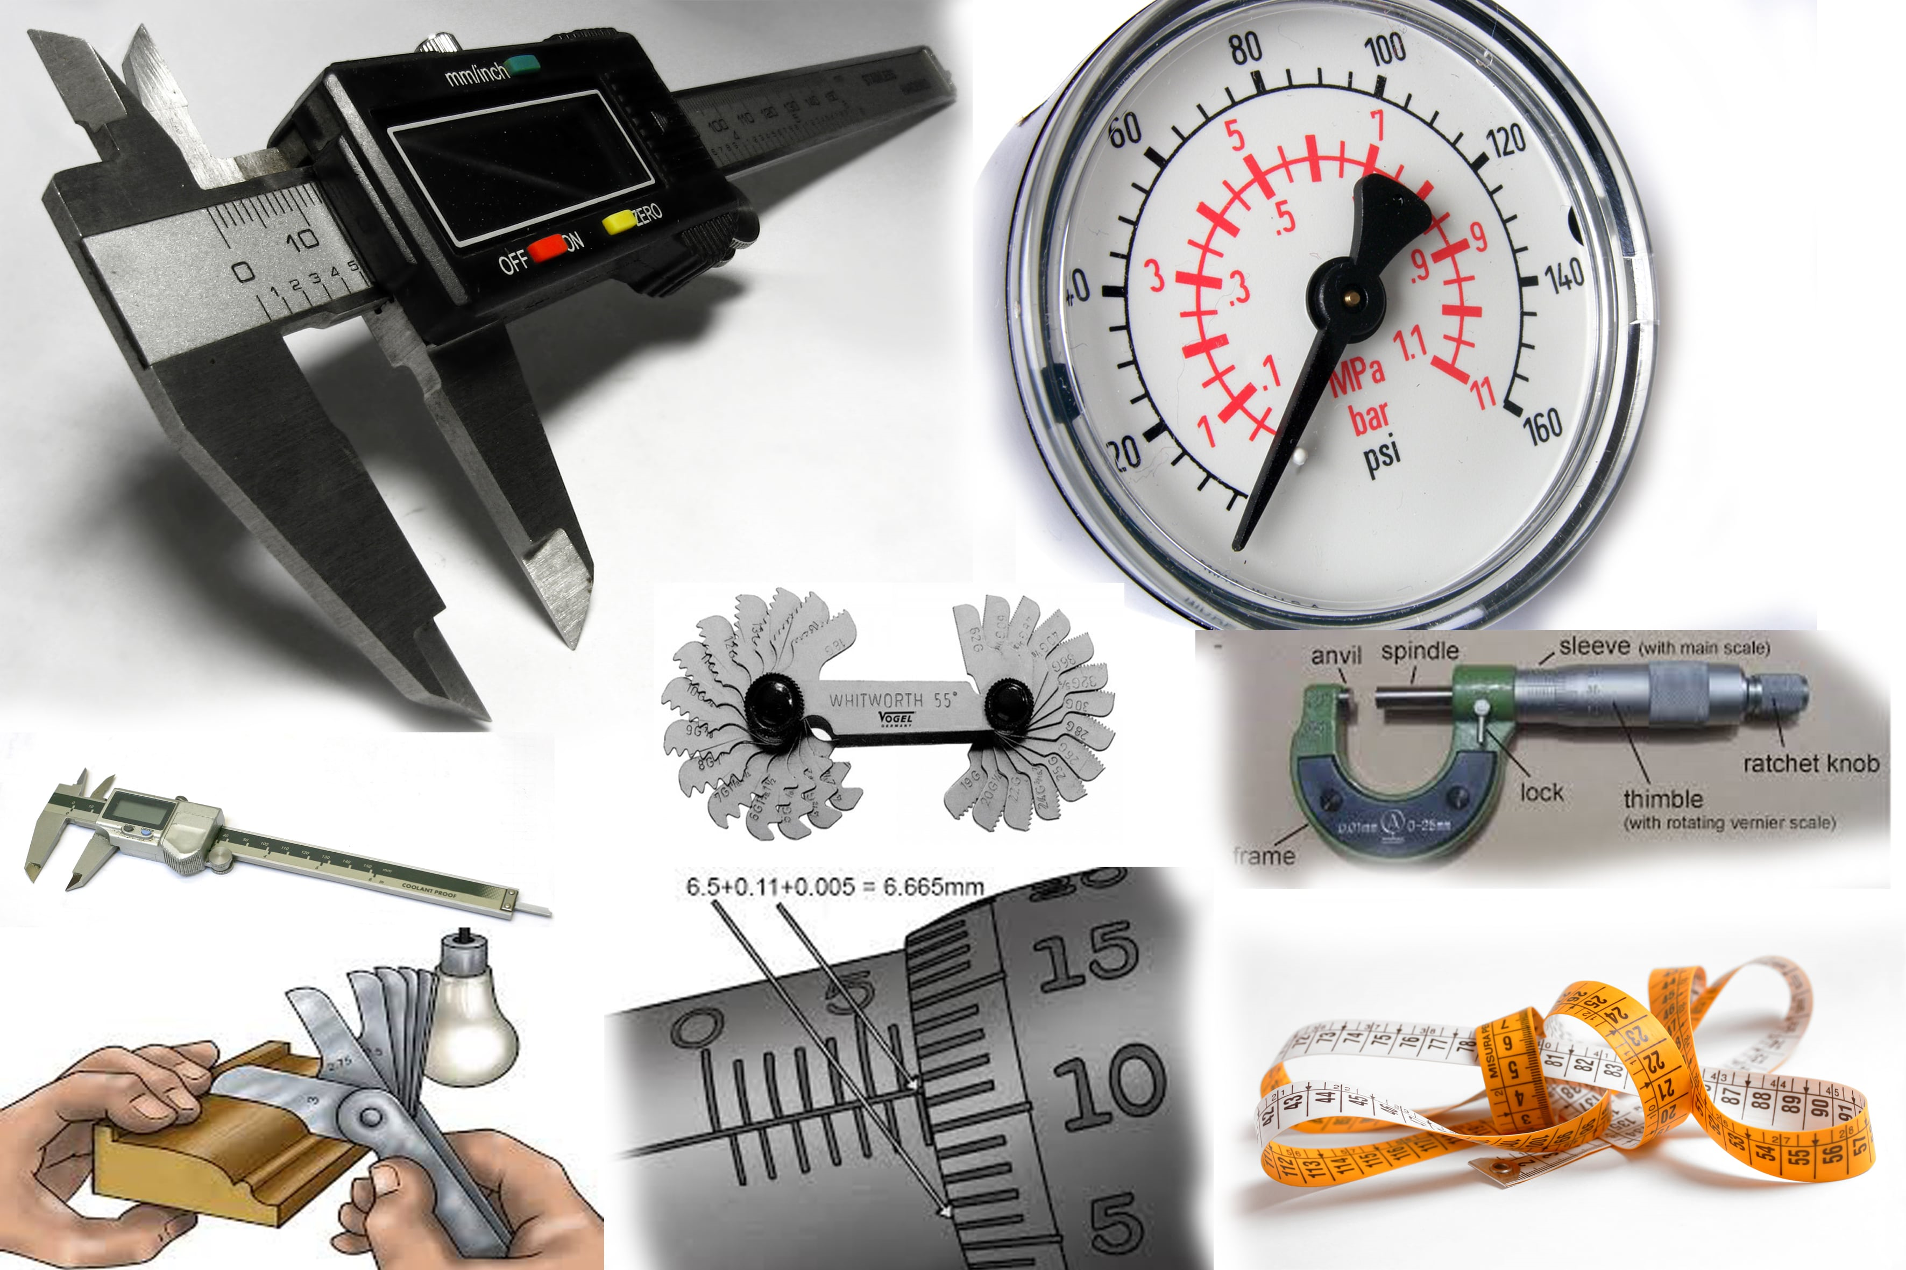
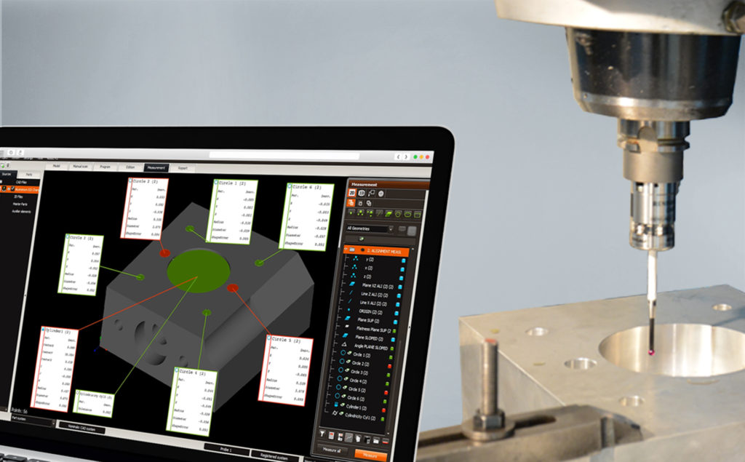
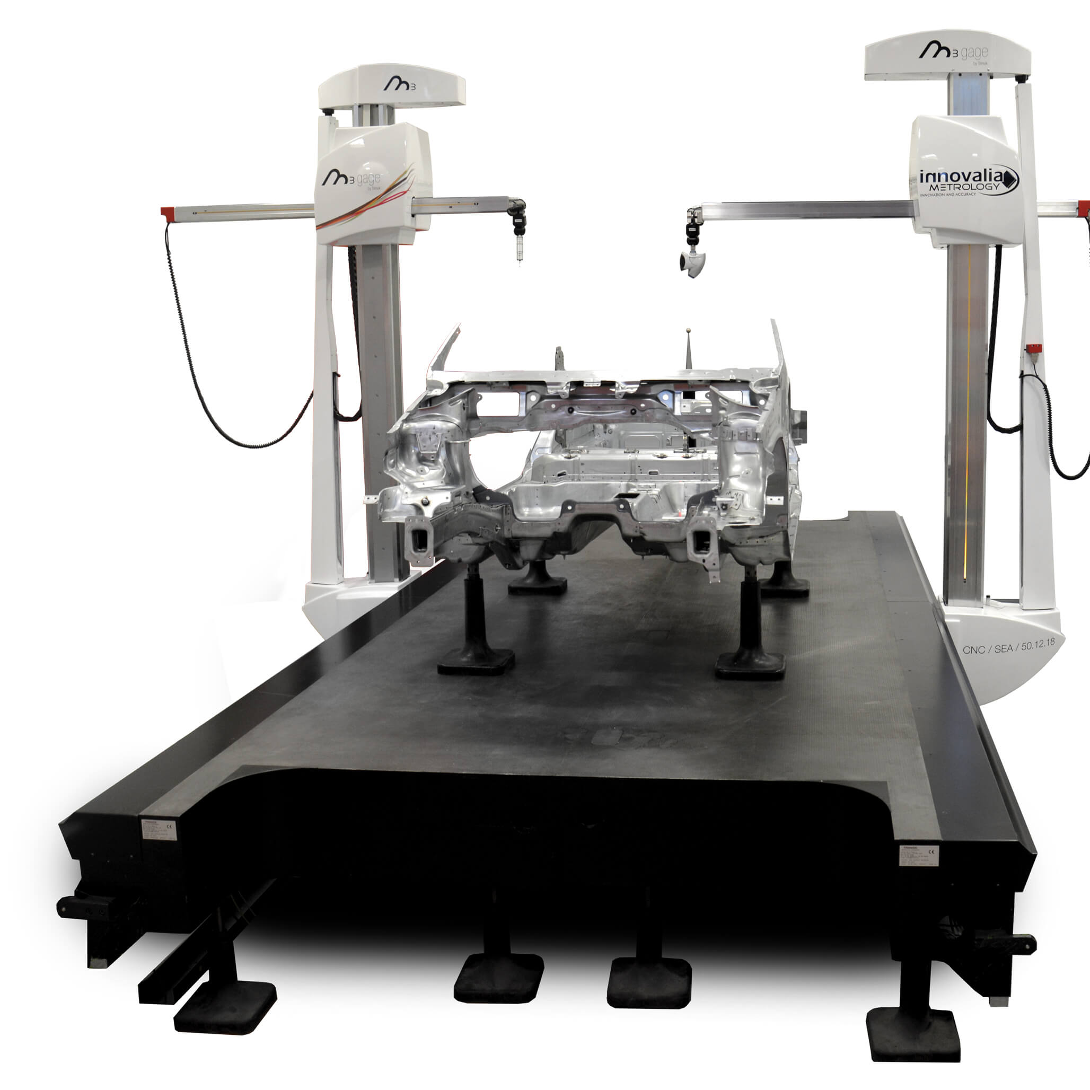
What is Industrial Metrology?
The word “metrology” originated from two Greek words, “Metron” meaning measurement, and “Logos” meaning study. Metrology is the scientific study of measurement.
It covers the calibration, maintenance, and quality control of measurement instruments and products used for industrial application and society in general, ensuring their suitability.
Each time products become more detailed and the limits of efficiency get pushed to new extremes, thus the manufacturing space has ever-tighter tolerances and precision to keep up.
However, achieving this level of precision is only the first step; tolerances need to be measured and verified through metrology.
Proper measurement is critical in the industry as it affects the value and quality of the final product.
Metrology is important in all day-to-day tasks as it provides some quantitative information on the actual state of physical variables and processes.

Slide 5
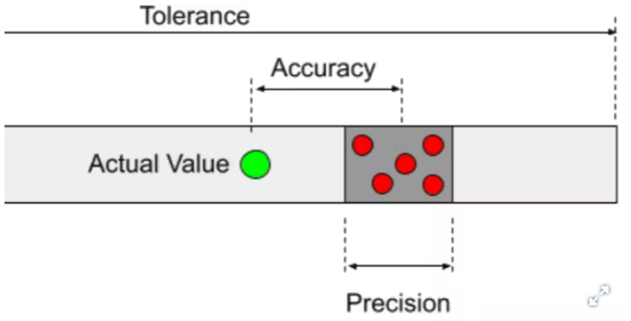
Some key concepts are…
Variation within a part's dimensions that is considered acceptable. A factor to consider is the manufacturing machine's ability to achieve these tolerances.
How close the average of a set of measured values is to the reference value, X. In manufacturing, this is the difference between the actual produced product and the CAD model or technical reference drawing.
How close each measurement is to the average of the measured values. Expressed statistically in terms of the standard deviation (𝜎). In metrology, the “standard” for standard deviation is ±2𝜎.
Expressions of precision and accuracy must also have an attached uncertainty value. This is the sum of the accuracy error and the precision error.

Slide 6
Quality Control sensors and software
3D laser scanner and point clouds management SW

Slide 7
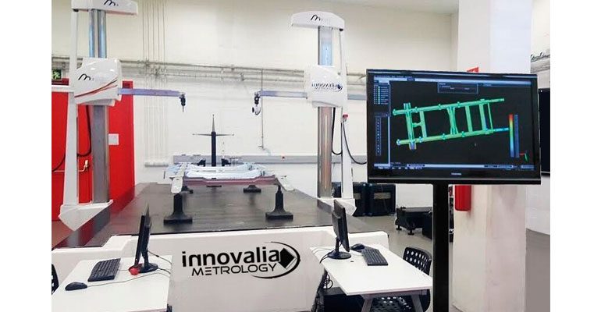
Devices used for Dimensional Quality Control
Non-contact sensors
Collects data from larger surface area in less time – high speed
Lower accuracy
Coverage of entire surface (not single measurement tracks)
Sensivity to surface characteristics
Contact sensors
Versatile and flexible
Sub-micron level of accuracy
Long measuring time
Unsuitable for flexible or deformable components
+ Metrology software
Coordinate Measuring Machine
Measures the geometry of physical objects by sensing discrete points with a probe or optical sensor, that can move along three axes, X, Y and Z, orthogonal to each other in a three-dimensional Cartesian coordinate system. CMMs provide accuracy in the order of microns.

Slide 8
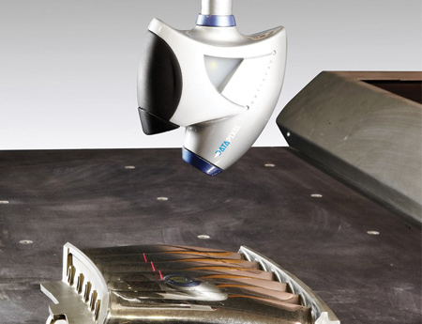
3D Laser Scanners
The one used for OPTIMAI Project (Microchip parts)
Generally use semiconductor lasers characterized by a red colored beam.
Digitization begins with the emission of a rectilinear laser beam which deforms on contact with the object.
Through the camera, the 3D scanner analyzes the deformation of the line emitted by the laser on the reliefs of the object in order to determine, by means of trigonometric calculations, its position in space.
Laser triangulation 3D scanners

Slide 9
Metrology Software
Capture the reality – actual parts digitization
Scan the part and capture its point clouds, obtaining a virtual part, a very precise digital copy with high fidelity representation of the surfaces to allow automatic dimensional analysis.

Slide 10
Reference arquitecture of the QC solution
Sensor + software package (inputs & outputs)

Slide 11
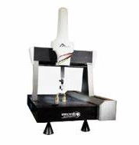
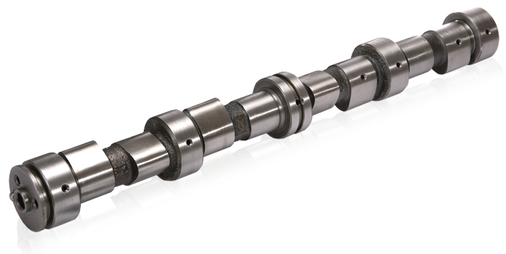
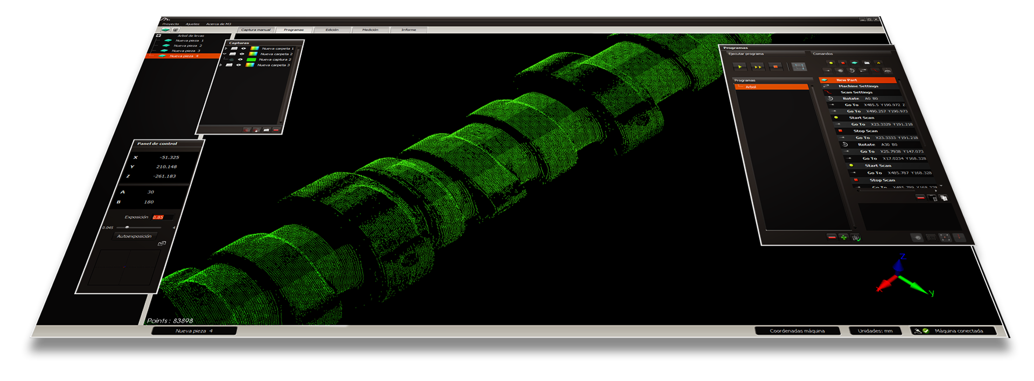
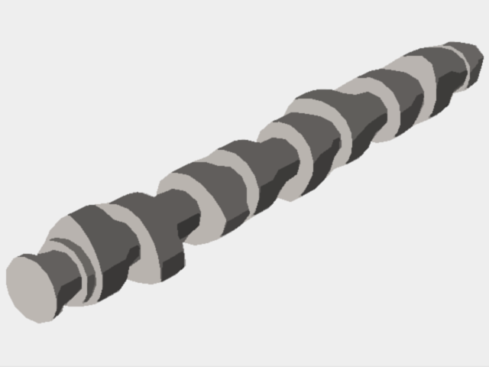
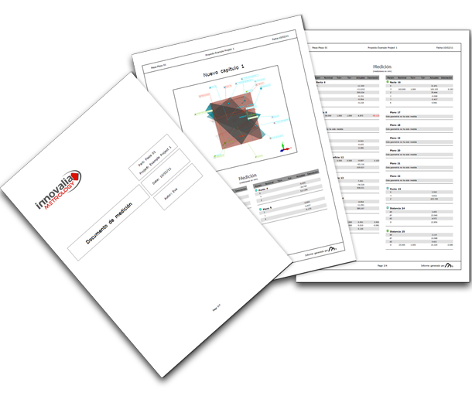
Workflow of the Solution 3D Scanner + M3 Software
Physical part
CMM
M3 software
Comparison of point clouds digital copy with CAD model
Disparity map
Optiscan
CAD model
Raw point cloud processing
Pointcloud digital copy
Results data in different formats as needed:
pdf report, stl with annotations, XML QIF file
See module related to QIF standard*

Slide 12
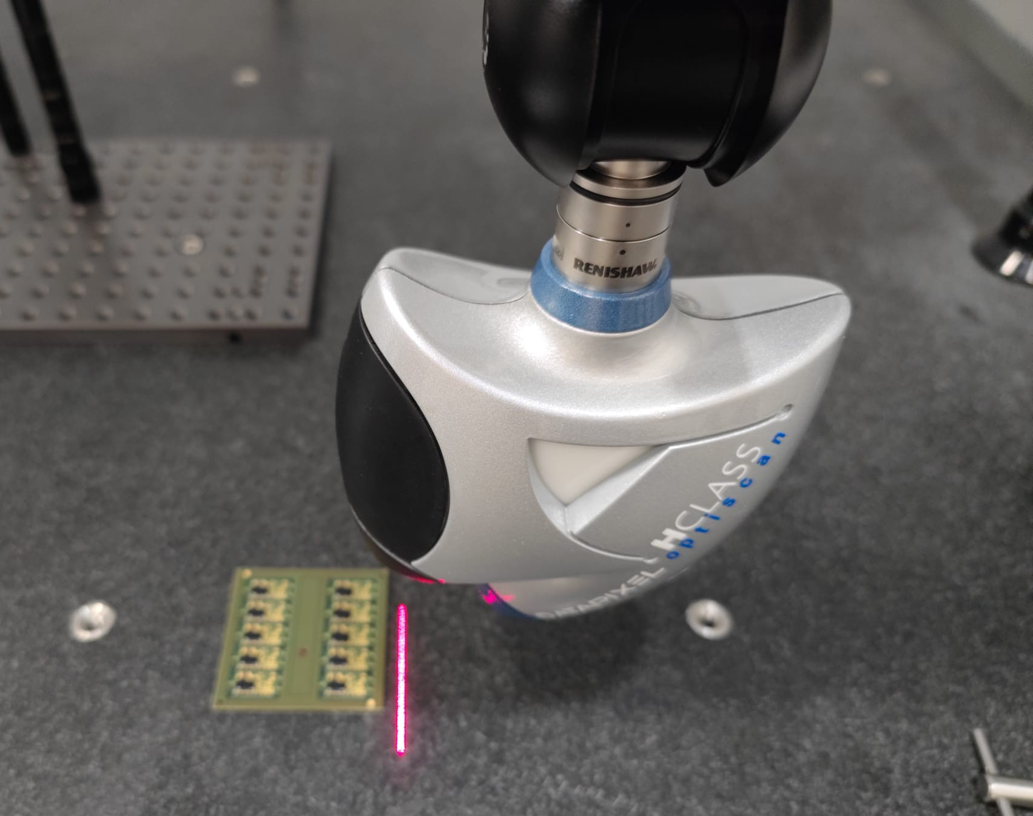
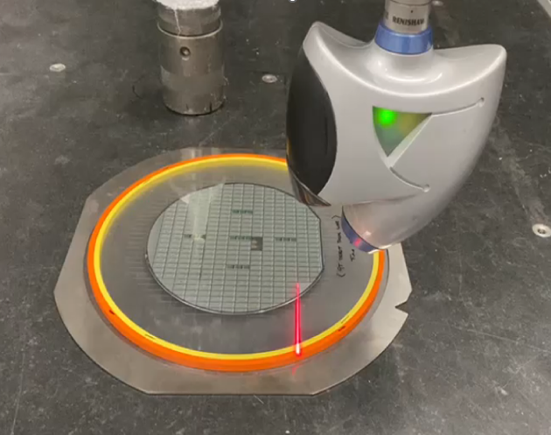
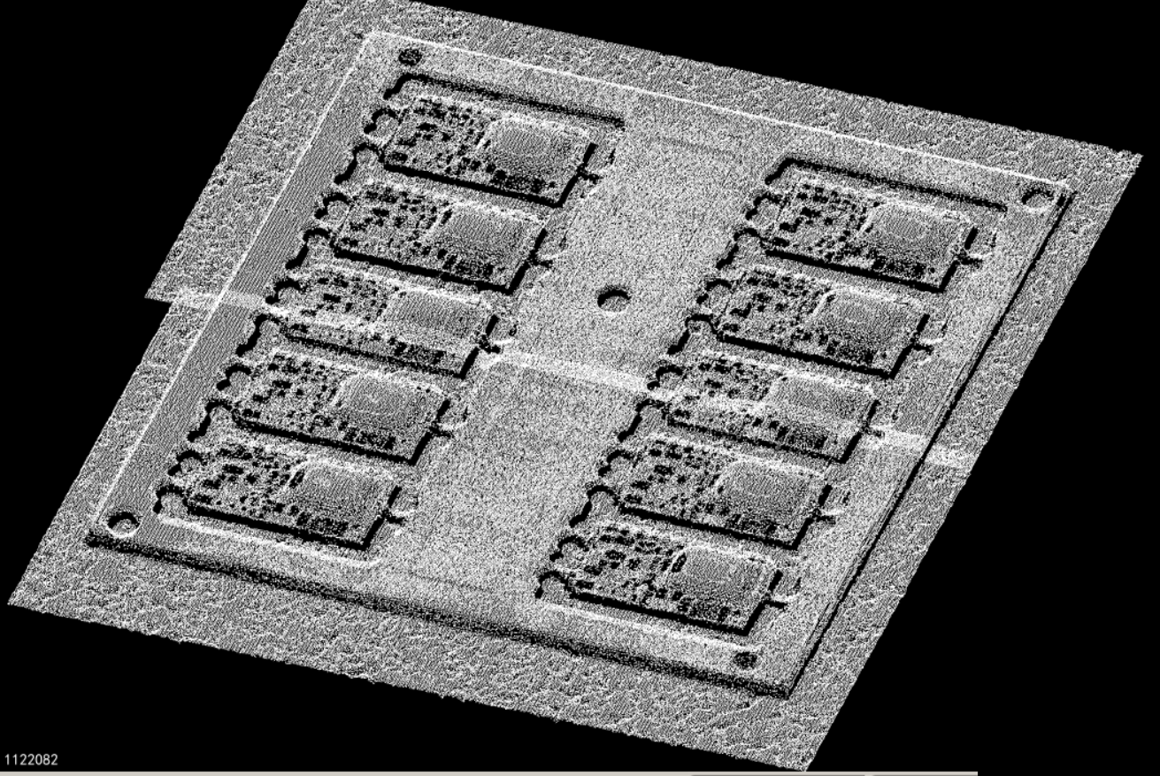
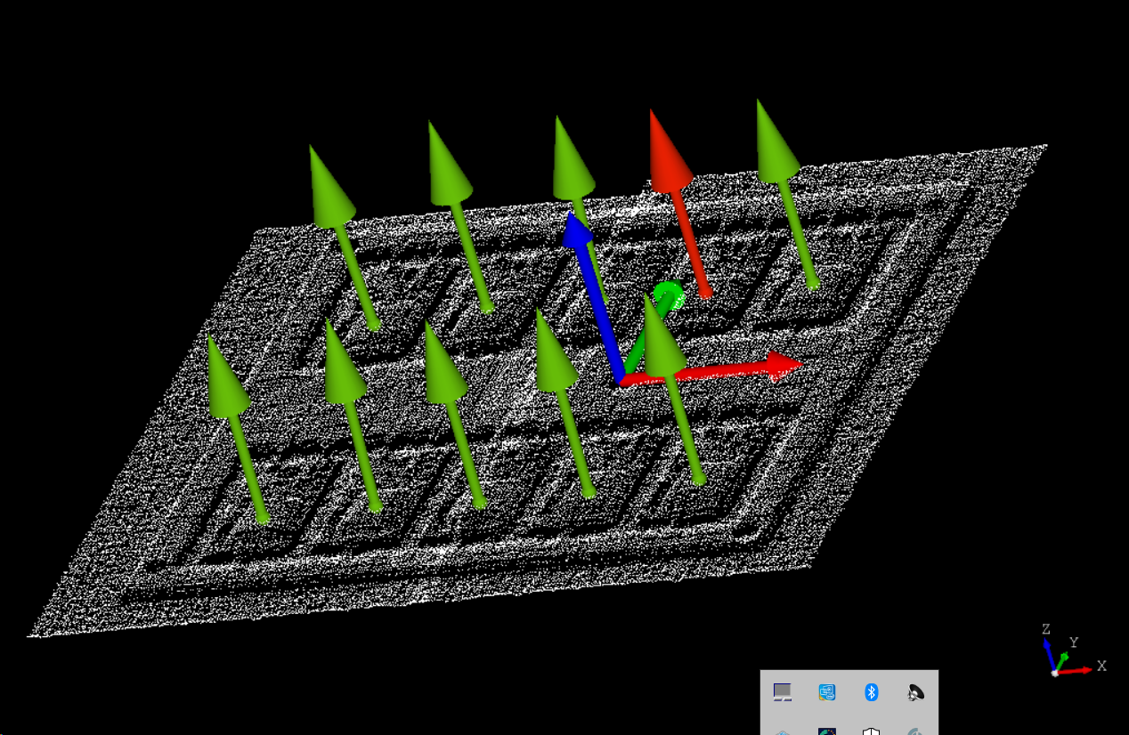
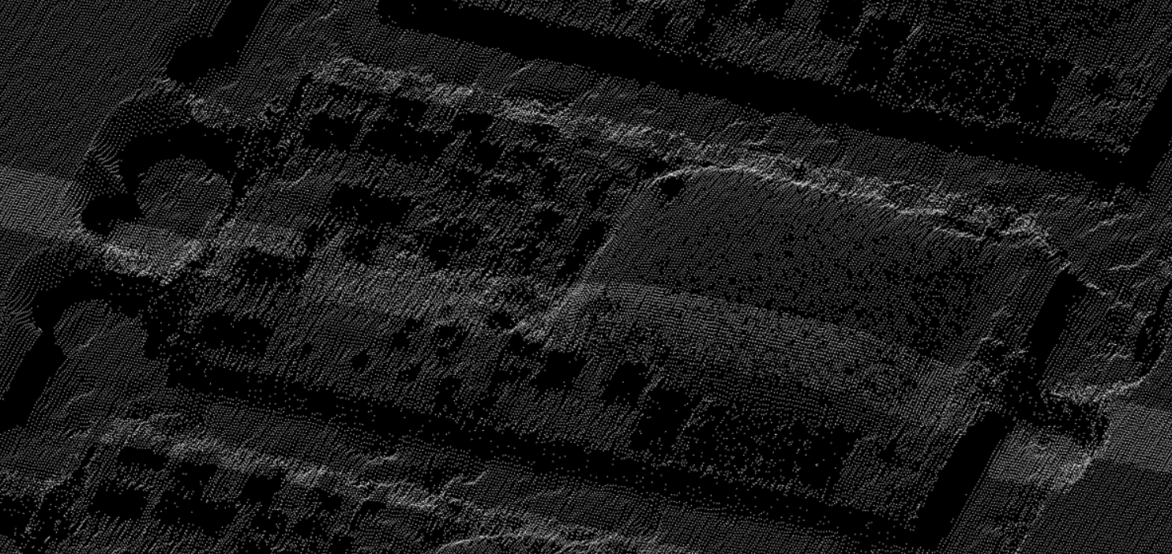
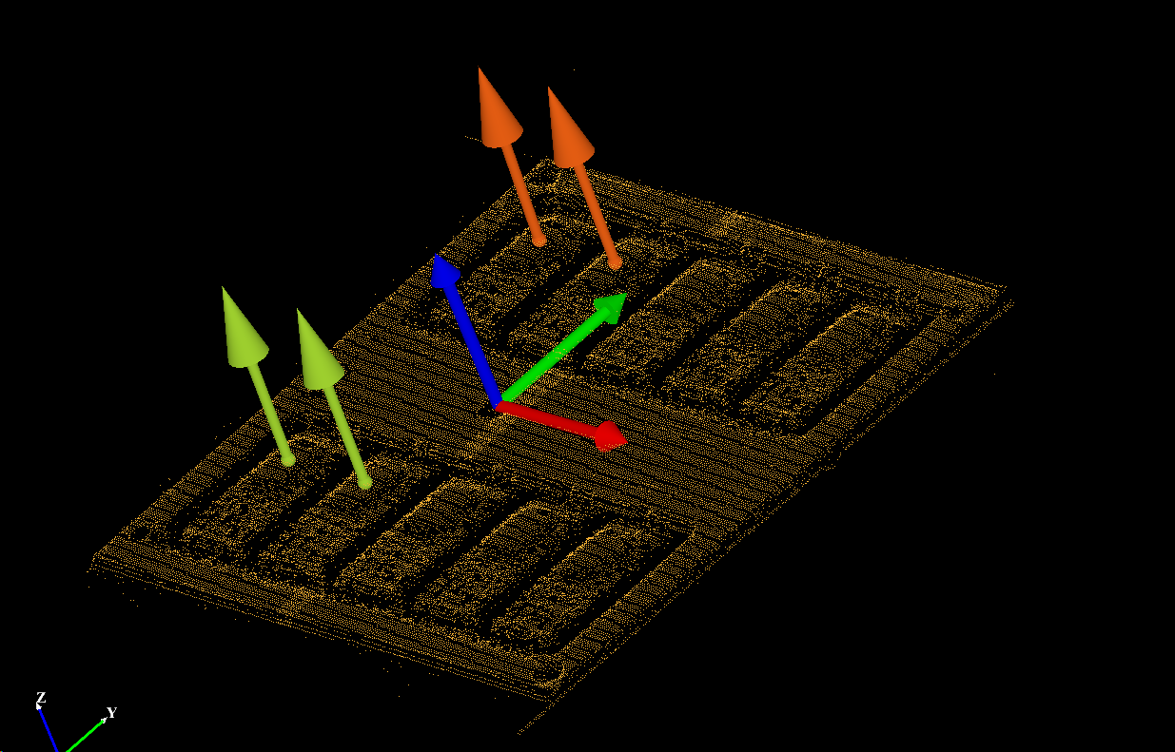
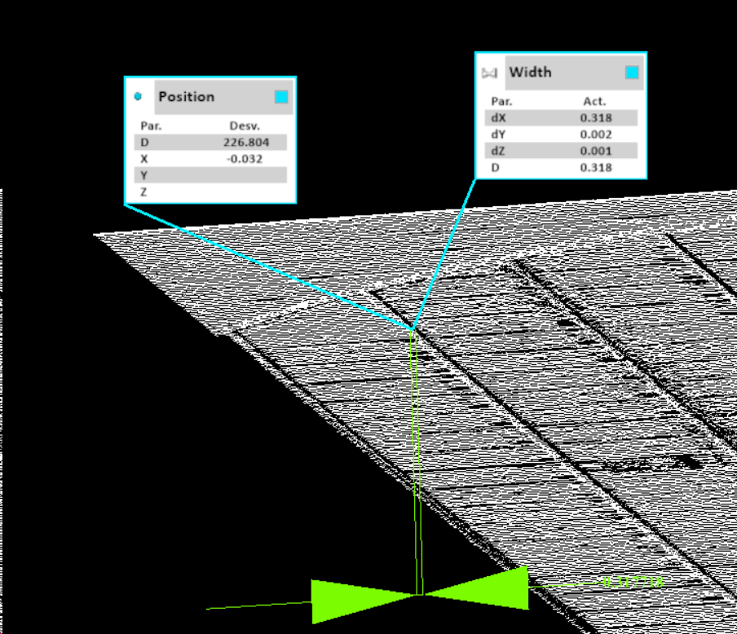
Work applied to Microsemi parts
M3 software
Physical part
CMM
Optiscan
3D laser scanner
Raw point cloud processing
Pointcloud digital copy
MTCL encapsulated PCBs and wafers
Measurement analysis

Slide 13
Basic Guide for the use of the Solution

Slide 14
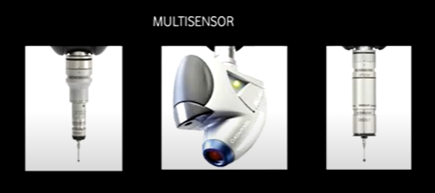
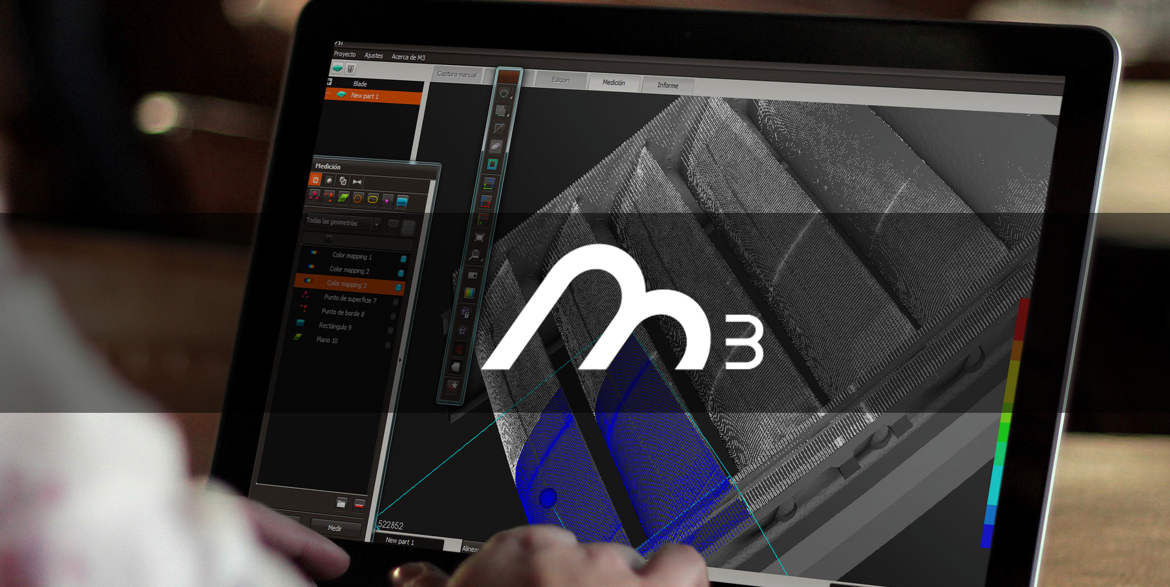
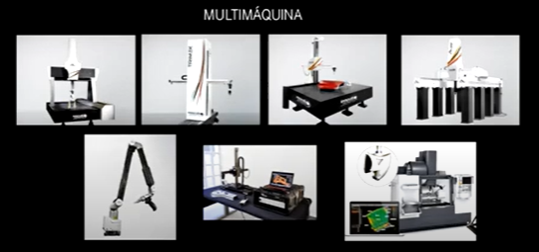
Principal Characteristics of M3
MULTISENSOR
+ Intuitive software user interface
MULTIMACHINE

Slide 15
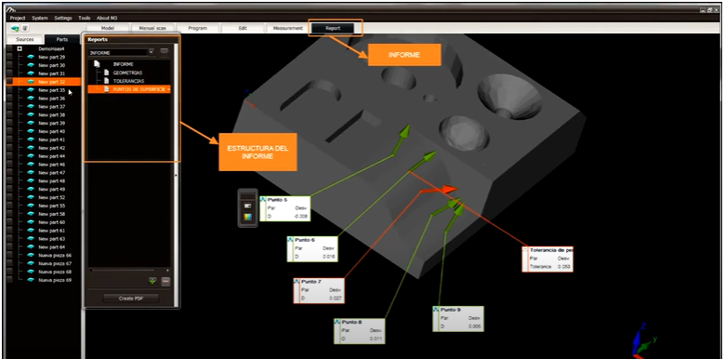
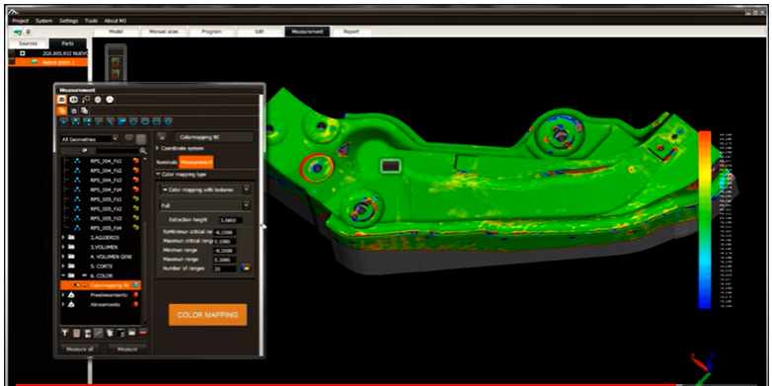
Workflow in M3 Software - General Steps
Upload the CAD file of the part to the software
Create a measurement plan based on a STEP file (preparation of all needed geometries required to perform the measurement in the machine)
Perform the alignments (as part of the measurement plan)
Prepare the geometric tolerances needed for the validation of the part
Run the measurement program (with an optical sensor in this case)
Connect to the machine and execute the programs that measure the geometries in the part
Generate the results visualization in the software, by selecting any of the geometries that have been measured
2 options for this visualization: Create a report or visualize a color deviation mapping image for a comparison between CAD design and the actual measured part.
Export results in different formats: QIF, DMO, CSV, STEP IGS

Slide 16
Next Steps

Slide 17
Next Steps
Additional information can be found at
https://www.innovalia-metrology.com/
https://www.unimetrik.es/

Slide 18
Thank you

