Slide 1

Gesture Vocabulary in OPTIMAI

Slide 2




Contents
Introduction and Functionality
Real-time Gesture Recognition Module
EgoGesture Dataset
Indicative Outputs

Slide 3

Introduction

Slide 4


What is Gesture Recognition?
Gesture recognition is the AI method deployed in the OPTIMAI project for understanding the operator’s motives in the factory floor using the AR glasses.
The AR functionalities allow the rapid adjustment of significant parameters and the ability to start/stop the inspection process of defected products, using a vocabulary of hand gestures. Thus, hand gesture recognition will be performed in the feed from the AR glasses aiming to understand the operator’s intentions.

Slide 5
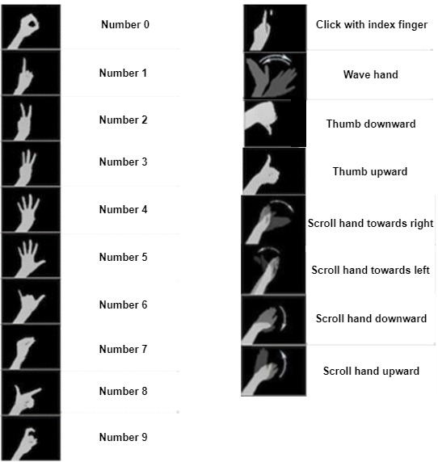
EgoGesture Dataset
All of the gestures required by the OPTIMAI necessities are included in the open-source EgoGesture dataset.
The defined gesture vocabulary contains 18 gestures described as:
  Numbers from 0-9
  Click with index finger
  Thumbs up/down
  Wave
  Swipe up/down/left right
^ (1) EgoGesture dataset

Slide 6
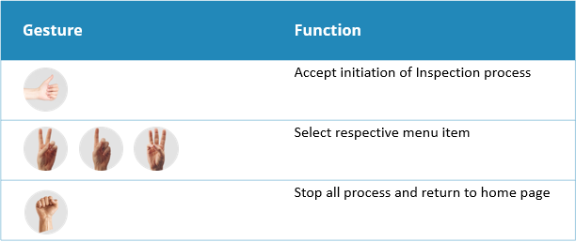
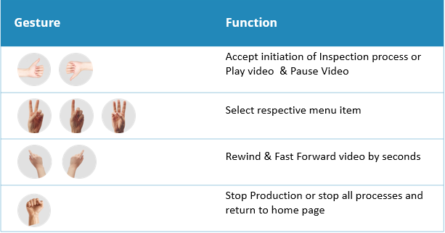


Functionality of the Gestures
The initial OPTIMAI gestures vocabulary is finalized for MTCL and TVES use case aiming to support the operators efficiently to interact with the system at the shop-floor.
Specifically, the users can utilize the implemented AR applications through gestures to activate functions related to the outputs of defect analysis provided by the OPTIMAI system.
(2) Gestures vocabulary for MTCL use case
(3) Gestures vocabulary for TVES use case

Slide 7

Real-time Gesture Recognition Module

Slide 8
Real-time Gesture Recognition Module
Regarding the gesture recognition task with real-time performance, the authors propose using the architecture that is presented in [1], [2].
The authors propose a workflow with a sliding window approach that activates the classifier upon detecting a gesture, using a detector as a switch. The proposed architecture is illustrated here.
Additionally, the workflow includes post-processing and single-time activation services

Slide 9
Real-time Gesture Recognition Module
The detector's main goal is to identify when a gesture takes place by analyzing a sequence of images, which is passed through the detector queue. The sole purpose of this component is to activate the classifier in case a gesture is detected.
In terms of a classifier, the authors use ResNext-10, although, as stated, their proposed architecture is independent of the actual model-type used for gesture classification purposes.

Slide 10


Real-Time Gesture Recognition Module
Post Processing: A typical cause for misclassifications and overall decreased system performance, when it comes to dynamic hand gestures, is hands moving out of the camera's field of view previous detector predictions. To combat this issue, they put forward a technique that utilizes the raw softmax probabilities from.
The proposed method involves a two-level control mechanism for achieving single-time activation. According to the authors, there are two possible scenarios for gesture detection: early-detection and late-detection. In the former case, the architecture detects a gesture when a threshold level is superseded by a confidence measure before the end of the gesture. In the latter case, when a deactivation of the classifier is triggered by the detector, there's a gesture prediction.

Slide 11
EgoGesture Dataset

Slide 12



EgoGesture Dataset
For the OPTIMAI purposes, training, validation and testing of the network is performed using the Egogesture dataset. This is a large-scale dataset of hand gesture recognition in an egocentric viewpoint, which contains all the gestures of interest for the purposes of OPTIMAI. It includes:
24,161 gesture samples using a wearable camera
With 83 gesture categories
Performed by 50 subjects
The dataset provides preprocessed skeleton data for each video sample, which can be used for gesture recognition and analysis. The dataset is freely available for research purposes.

Slide 13
Indicative Outputs
Notes:
Rights of Data Subjects

Slide 14
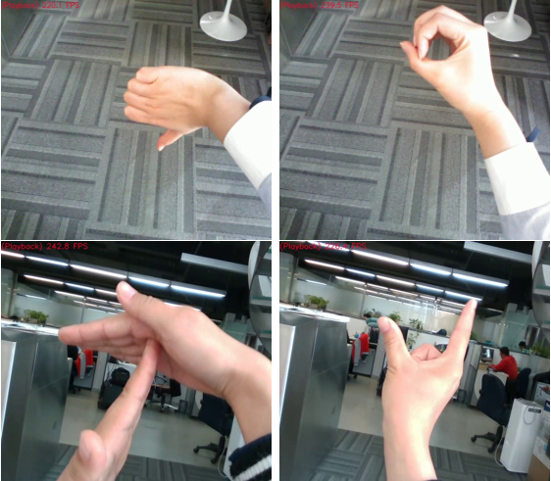
Indicative Outputs
In this section, some sample outputs (frames) that are produced during online testing of the network in its current stage of development and improvement for the purposes of OPTIMAI are demonstrated.
These images serve as a demo for the gestures that are captured from the video. The sample images show four of the gestures in the vocabulary that are captured from video sources that are inputted to the network

Slide 15

Thank you!

