Slide 1
OPTIMAI Augmented Reality Interface

Slide 2
Content
Introduction and Objectives
Microelectronics Production Use Case
Antennas Production Use Case
Lifts Manufacturing Use Case
Gestures

Slide 3
Introduction and Description

Slide 4
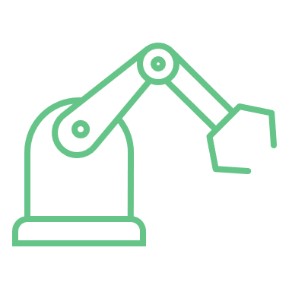
Introduction and Description
The three applications were designed to be unique to each pilot site, with specific features and functionalities that met the needs of each site.
These prototypes were developed to test the feasibility of using the designed library in real-world scenarios and to evaluate their potential to improve the operations of the pilot sites.

Slide 5
Microelectronics Production Use Case

Slide 6
Home screen of microelectronics application
The application designed for the Microelectronics Production Line starts with the Home Screen.
In the home screen, there is a menu on the top right corner of the screen that includes the options New material, Inspection, and Defect Alerts.
The user can select each of the three options with the hand gesture finger count indicating the number of the corresponding item

Slide 7
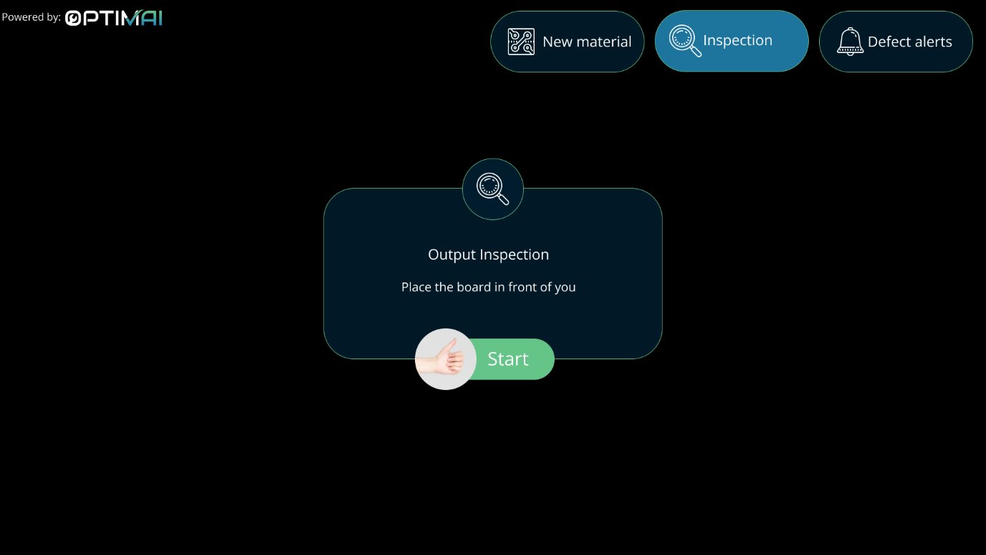
Inspection Mode
The main functionality of this application is the Inspection Mode
In the Inspection mode the user can inspect a PCB board to determine the faulty parts that need to be rejected. After selecting the Inspection mode, a pop-up message is displayed that prompts the user to place the PCB in front of them and start the process
When the user is ready, they perform a thumbs-up gesture and the Inspection begins.

Slide 8
Application UI During the Inspection Mode of the PCB
During the Inspection, the user sees through the glasses the PCB and the modules of the PCB annotated with a coloured square and their number.
The colour of the square indicates the status of the module:
Green for acceptable
Yellow for borderline acceptable
Red for rejectable.
Some widgets are presented in a low Level of Detail (LoD) (modules 1-12, 15-18) and others in a High LoD ( modules 13, 14)

Slide 9
Application UI During the Inspection Mode of the PCB
High LOD widgets
Low LOD widgets
The High LOD widgets are an exact representation of the inside of the module and each dispensing area is annotated with the status colour and the arrow indicating the sufficiency/insufficiency of the glue, as explained above.
Represent the number of dispensing areas that have:
Excessive glue and are rejectable
Insufficient glue and are rejectable
More glue but are acceptable
Less glue but are acceptable
Normal

Slide 10
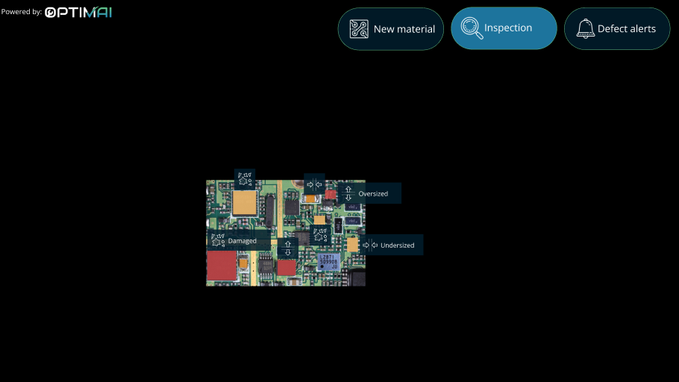
Inspection of PCB After Routing Process
Another mode of inspection is one of the PCB after the routing process has been completed.
The areas of interest are detected and coloured with the three colours of status (green, yellow, red) and a widget is attached to each one indicating the defect.
The defects can be
oversized chip
undersized chip
damaged chip

Slide 11
Inspection of wafer after Wafer Sawing
Finally, the inspection of the wafer after the sawing process indicates the faulty areas on the wafer and a message that explains the defect.
The defects can be:
Chipping
Cracking
Incorrect depth

Slide 12
Antennas Production Use Case

Slide 13
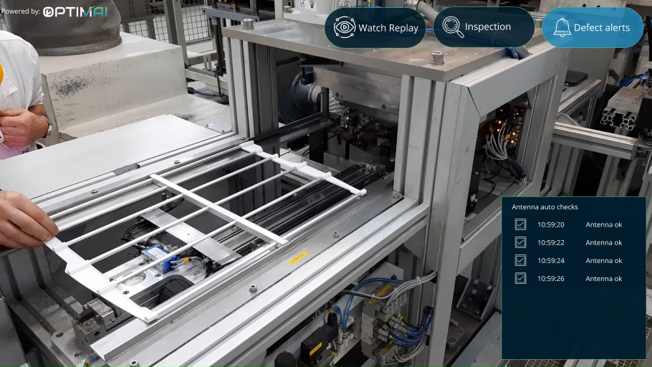
Antennas production Use Case
The application designed for the antennas production line starts with the initial home screen that contains only a menu. The menu includes the Watch Replay, Inspection and Defect Alerts options.
The user can select one of the three options by performing the gesture finger count: one for the first item (Watch Replay), two for the second (Inspection) and three for the third (Defect Alerts).
The Defect Alerts Option enables the real-time notifications box at the bottom right corner of the UI. In this alert box, for each antenna being checked, an alert with the timestamp and the status of the antenna is received.
^ Antennas production line UI after the user has selected Defect Alerts tab

Slide 14
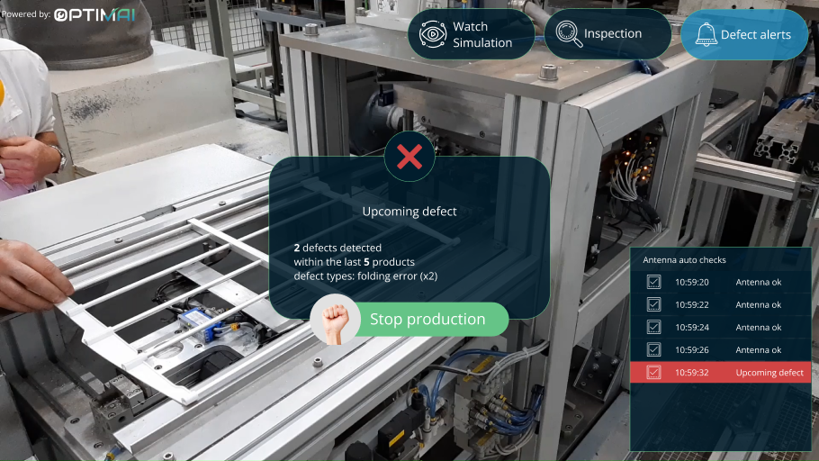
Antennas production Use Case
If a defective antenna is detected or the system predicts an upcoming defective one, a pop up message shows up on the Production Line Operator’s (PLO’s) field of view.
^ The system has predicted an upcoming defective product

Slide 15
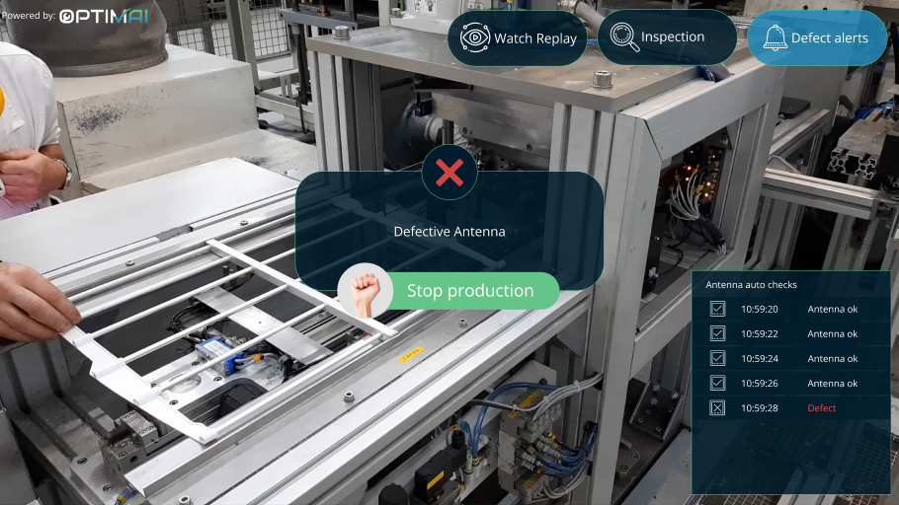
Antennas production Use Case
The system has detected a defective antenna

Slide 16
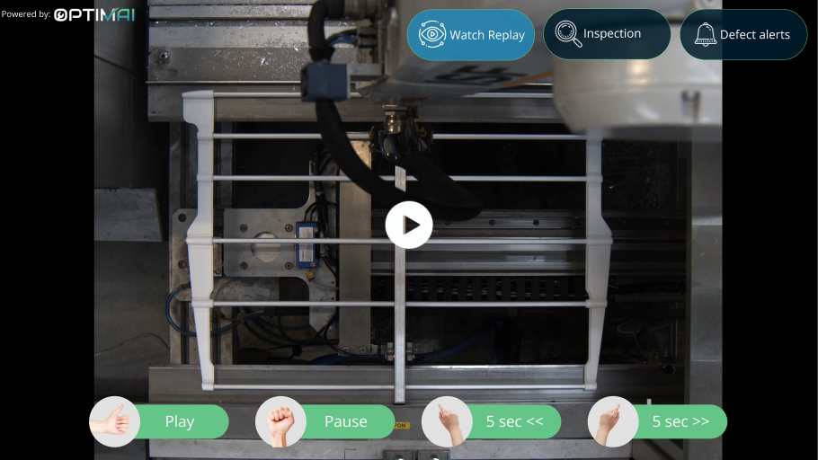
Antennas production Use Case
In the case of a predicted defect, the message also indicates the reasons for generating this prediction. The operator can then stop the production with the closed fist gesture and watch a replay video of the occurred defect or a simulation video of the predicted defect, controlling the video replay through mid air gestures indicated at the bottom side of the screen
^ Replay of the detected defect
^ Video simulation of the predicted defect

Slide 17
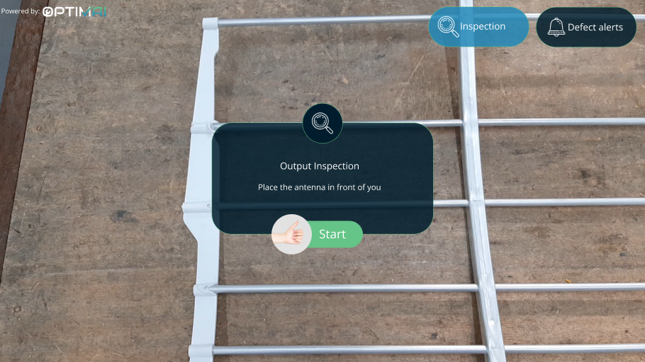
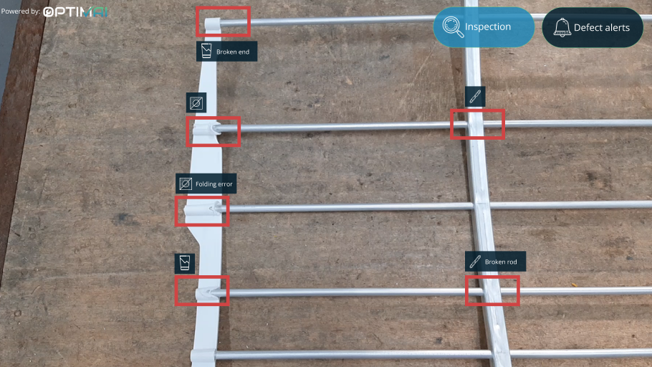
Antennas production Use Case
In the case of a detected defect, the operator can then perform a manual inspection of the antenna by selecting the ‘Inspection’ menu option To do so, they place the antenna in front of them and initiate the inspection through the thumbs up gesture.
^ The UI after the user has selected the Inspection item form the menu
Then, the system detects and annotates detects and annotates the defective areas through a highlighter frame and provides the respective cause laterally to the defected area, through appropriate icons. The defects detected include a broken end, a broken rod, and a folding error.
^ The process of defect inspection

Slide 18
Lifts Manufacturing Use Case

Slide 19
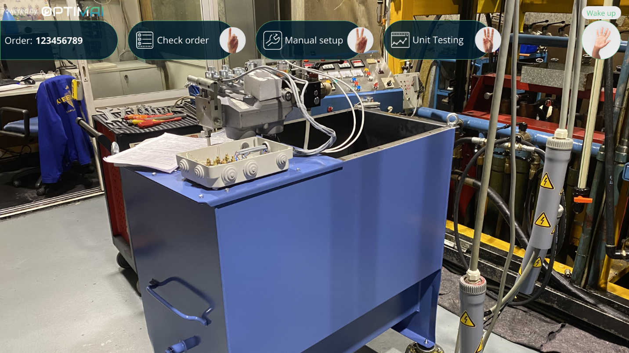
Lifts Manufacturing Use Case
The application for the lifts manufacturing use case includes various scenarios since this manufacturing process consists of various steps.
The Home Screen of the application includes the menu featuring three options: Check Order, Manual Setup and Unit Testing. In the top left corner there is also the ID of the order that is currently being handled.
^ Lifts Manufacturing application home screen

Slide 20
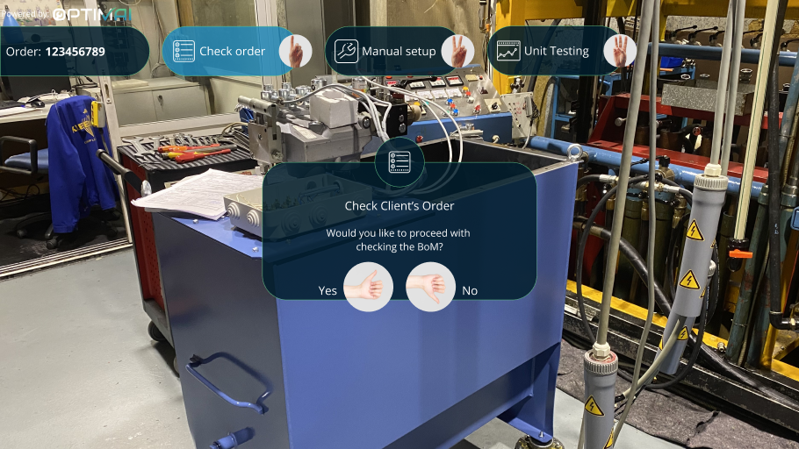
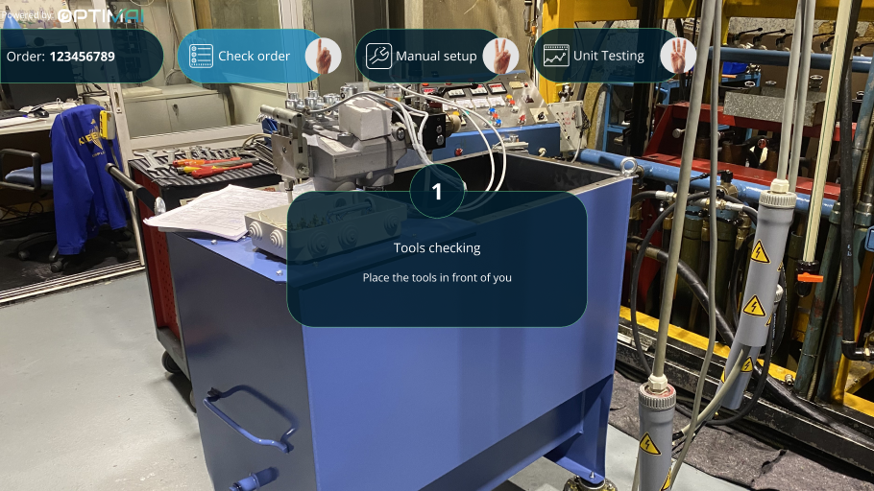
Lifts Manufacturing Use Case
To select the first menu item and check an order, the user has to perform the Finger Count One gesture. In this case, a popup message appears asking the user to confirm that they would like to check the specific Bill of Materials (BoM)
^ Confirmation for checking the BoM of an order
Upon confirmation with the appropriate gesture, the system displays a pop-up providing instructions to the user, regarding the first step of the process, the tools checking part
^ Instructions for tools checking

Slide 21
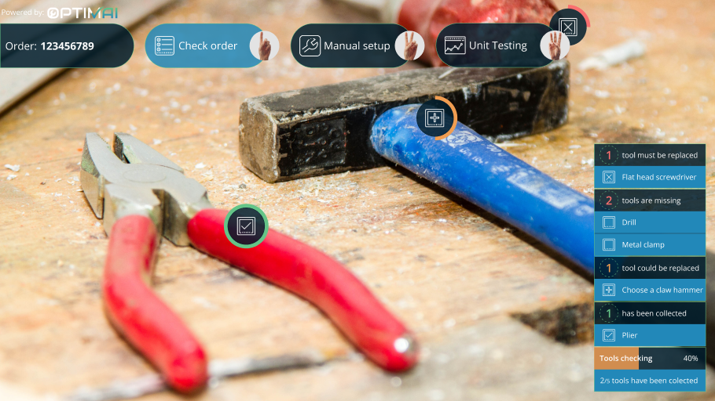
Lifts Manufacturing Use Case
Then the user, looking at tools , looking at the tools through the AR glasses, receives feedback from the system regarding their status.
The system provides confirmation for:
The appropriateness of a specific tool,
Tools that need to be replaced
Missing tools
Information regarding tools is displayed in a notification window as well as through appropriate icons overlaid on top of the tools.

Slide 22
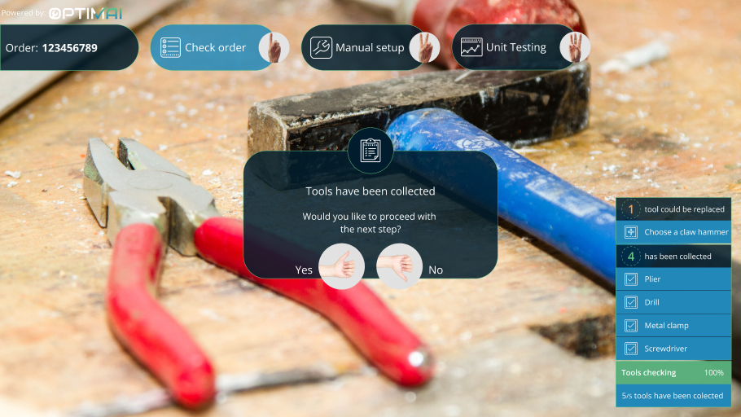
Lifts Manufacturing Use Case
The next phase pertains to checking the unit parts, upon confirmation from the user
^ Initiation of the order checking process

Slide 23
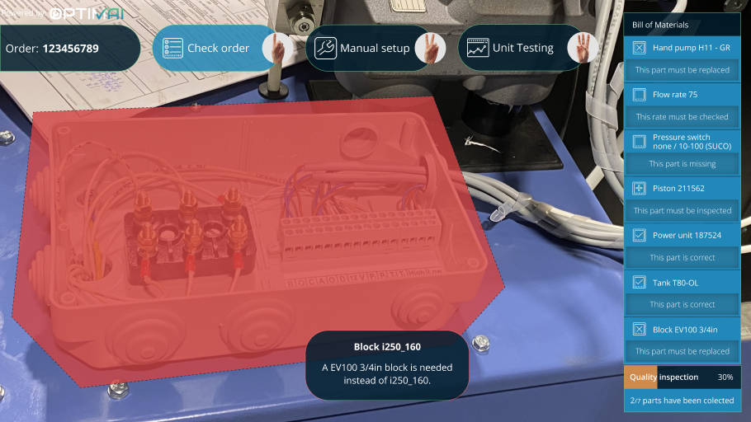
Lifts Manufacturing Use Case
The user initiates the process with a thumbs up gesture and the tools checking process begins. The user focuses on the unit and the system provides feedback on the various unit parts
^ The unit parts are being detected and checked

Slide 24
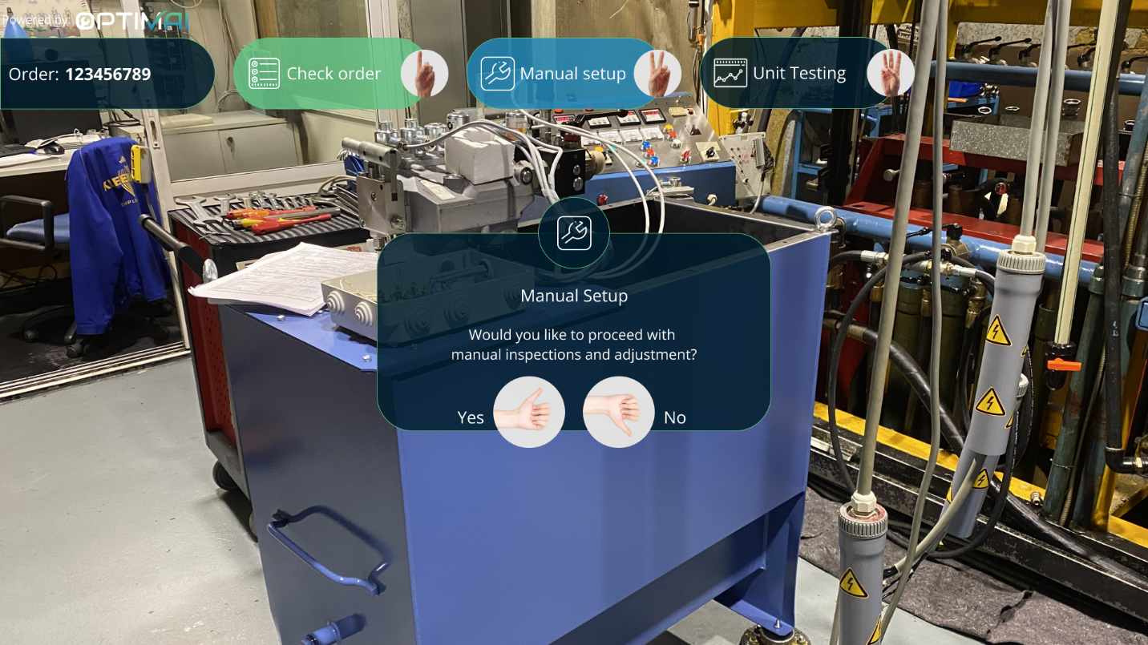
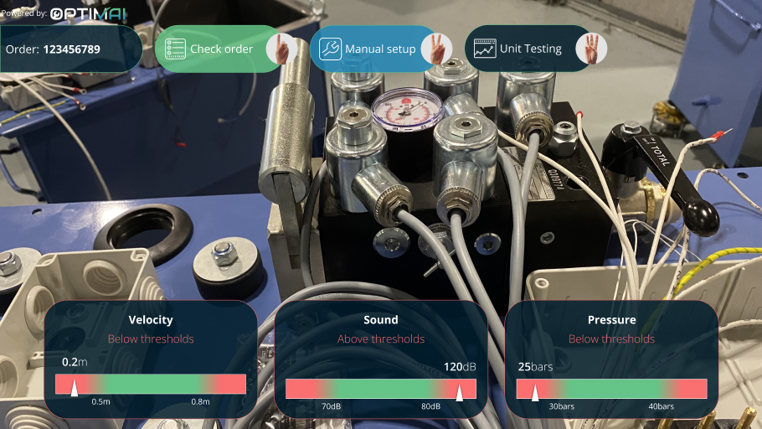
Lifts Manufacturing Use Case
When everything is checked the system prompts the user to start the manual setup. The user has to adjust the valve blocks while inspecting the velocity, sound and pressure values
^ The manual set up process begins
^ The velocity, sound and pressure parameters are being checked

Slide 25
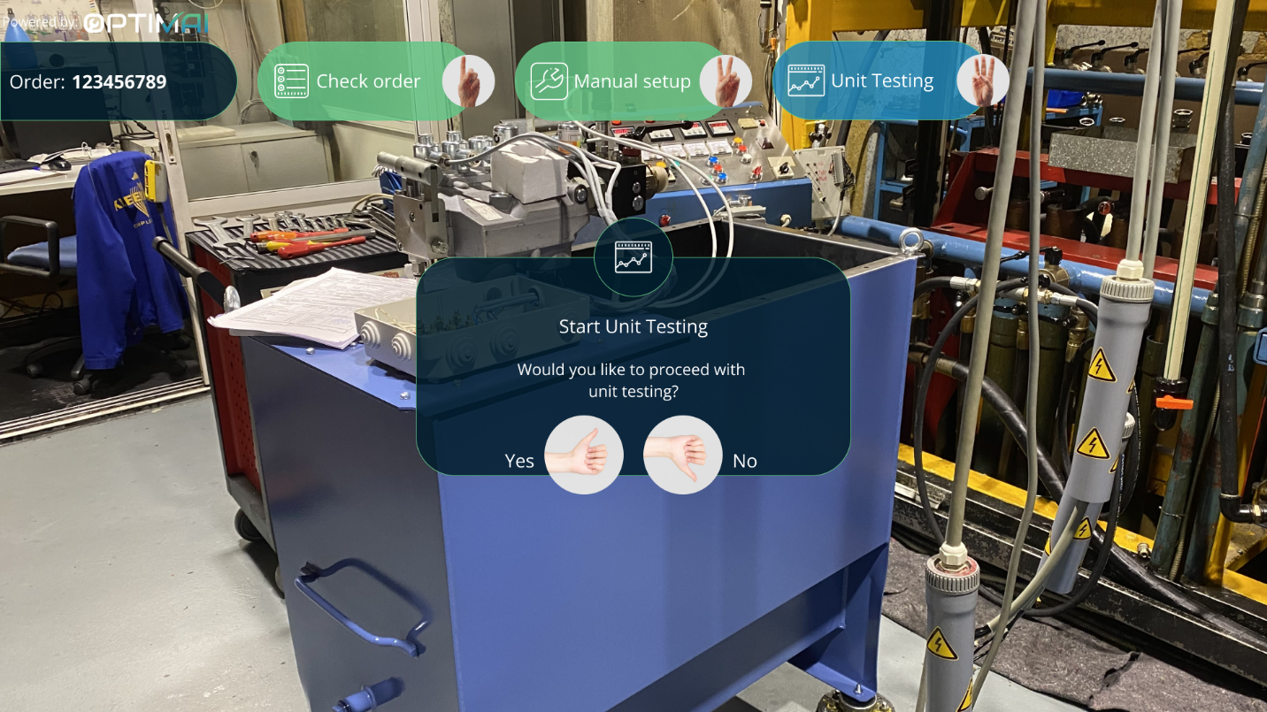
Lifts Manufacturing Use Case
Finally, the unit testing begins
^ Initiation of the Unit Testing Process

Slide 26
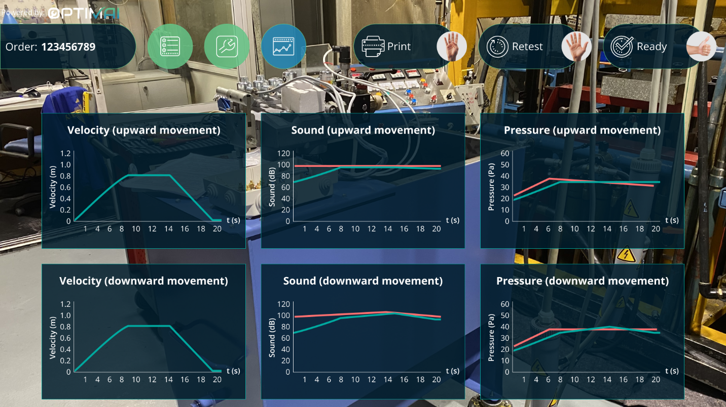
Lifts Manufacturing Use Case
The operator can see all the diagrams on their field of view in order to inspect them. Then they have three options to either Print the results, retest if there were issues found and finish all processes.
^ The diagrams of the parameters (velocity, sound, pressure) are displayed

Slide 27
Gestures

Slide 28
Gestures
Finger Count
The users lift as many fingers as the index of the menu item they wish to select (e.g., if they want to choose the second element of the menu they need to lift two fingers). The menu component in the operator’s field of view is designed to include three items, thus by integrating the finger count gesture, the operator has to use only one of his hands. The finger count gesture is also natural to the users, since it is used in everyday life as well.

Slide 29
Gestures
Opening & Closing Fist
Through the various tasks the PLOs have to complete, whenever a defect occurs in the production line, they might need to stop the production for a while, to avoid the upcoming defects and recalibrate the systems involved. Since this operation requires a rapid reaction, the gesture of closing and opening fist is suitable for this interaction

Slide 30
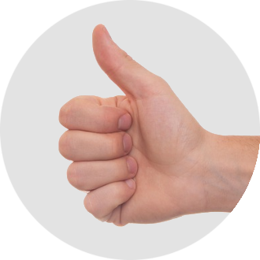
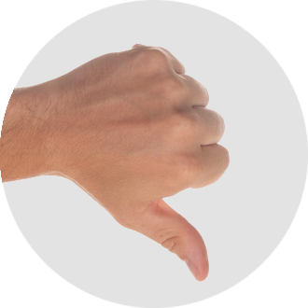
Gestures
Thumbs Up & Thumbs Down
Through the AR UI, the PLOs can initiate specific processes (e.g., Output Inspection, Tools checking etc.), by selecting a menu option with the finger count gesture. In order to initiate one of these processes, after a pop-up message appears, the PLO has to confirm by performing the thumbs up gesture, or decline to start the process by performing the thumbs down gesture.

Slide 31
Gestures
Swipe Up & Swipe Down
The PLO can wake up the system when they need it, by waving their hand in the air.

Slide 32
Gestures
Wave
The swipe gesture is used for the recalibration of the system. For example, if the glue quantity is found excessive after the glue dispensing process, the PLO will have to decrease the nozzle pressure. This can be done by swiping down gesture, simulating the movement of lowering a bar. If the operator needs to increase the value of a parameter in the system, she/he can perform the opposite gesture (swipe up).

Slide 33
Thank you!

